Slide 1
Data Analysis and Visualisation
(Penalised) Logistic Regression Modelling

Slide 2
Logistic Regression Modelling
Binary logistic regression modelling allows us to model a binary outcome (e.g. yes/no) with one or more (categorical / continuous) predictors.
Logistic regression allows users to quantify the relationship between the outcome variable and each of the predictors through the use of probabilities and odds.
Logistic regression models the probability that the response falls into one of the two categories.
Linear regression would not be appropriate in this situation as the predicted values from LR are unbounded.
Notes:
Cluster analysis is an “unsupervised” technique and makes no assumptions regarding the number of groups or the group structure.

Slide 3
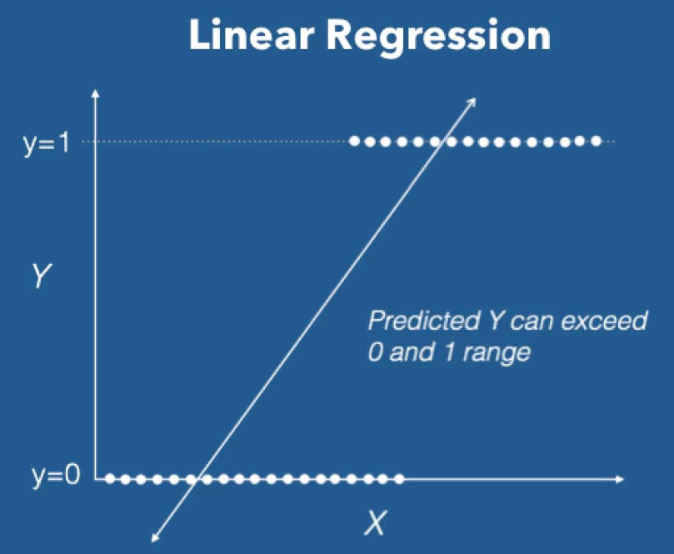
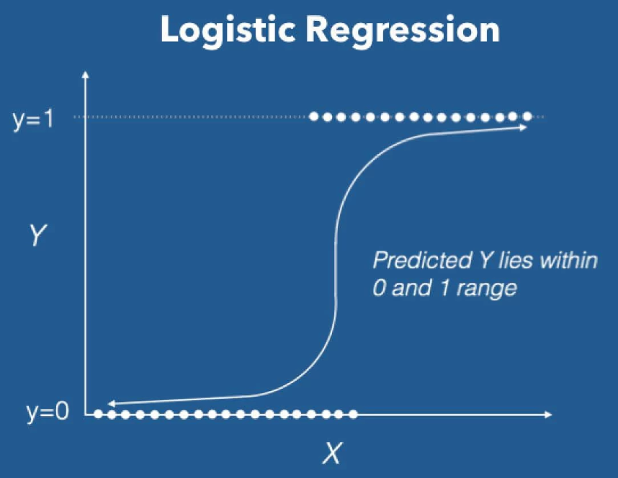
Logistic Regression Modelling
Linear Regression VS Logistic Regression
Notes:
Cluster analysis is an “unsupervised” technique and makes no assumptions regarding the number of groups or the group structure.

Slide 4
Logistic Regression Modelling
Examples of binary classification problems
Spam Detection : Predicting if an email is Spam or not.
Credit Card Fraud : Predicting if a given credit card transaction is fraud or not.
Health : Predicting if a given mass of tissue is benign or malignant.
Marketing : Predicting if a given user will buy a product or not.
Banking : Predicting if a customer will default on a loan.
Notes:
Cluster analysis is an “unsupervised” technique and makes no assumptions regarding the number of groups or the group structure.

Slide 5
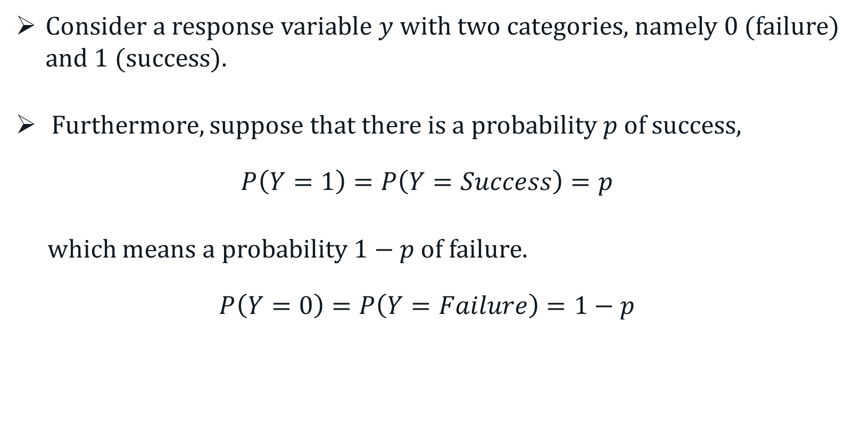
Logistic Regression Modelling
Consider a response variable $y$with two categories, namely 0 (failure) and 1 (success).
Furthermore, suppose that there is a probability $p$ of success,
$$P\left(Y=1\right)=P\left(Y=Success\right)=p$$
which means a probability $1−p$ of failure.
$$P\left(Y=0\right)=P\left(Y=Failure\right)=1−p$$
Notes:
Cluster analysis is an “unsupervised” technique and makes no assumptions regarding the number of groups or the group structure.

Slide 6
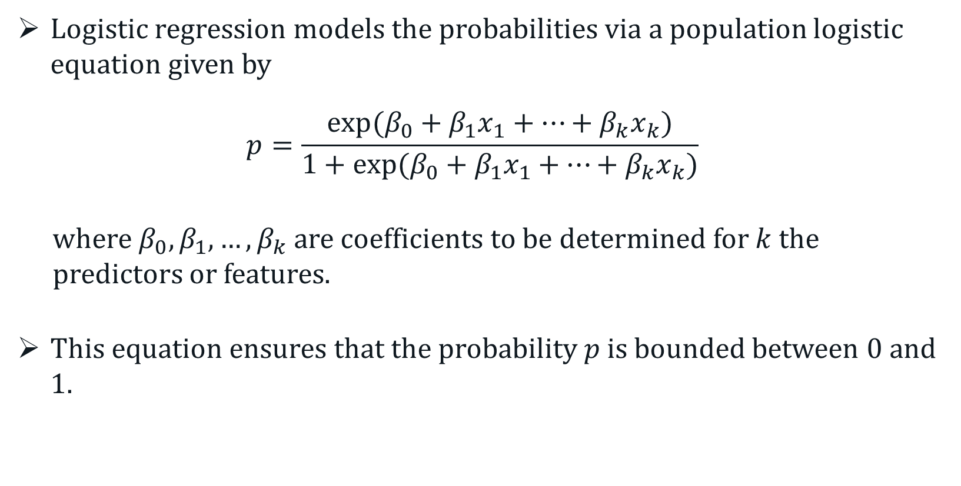
Logistic Regression Modelling
Logistic regression models the probabilities via a population logistic equation given by
$$p=\frac{exp⁡(β_{0}+β_{1}x_{1}+…+β_{k}x_{k})}{1+exp⁡(β_{0}+β_{1}x_{1}+…+β_{k}x_{k})}$$
where $β_{0}, β_{1},…,β_{k}$ are coefficients to be determined for $k$ the predictors or features.
This equation ensures that the probability $p$ is bounded between 0 and 1.
Notes:
Cluster analysis is an “unsupervised” technique and makes no assumptions regarding the number of groups or the group structure.

Slide 7
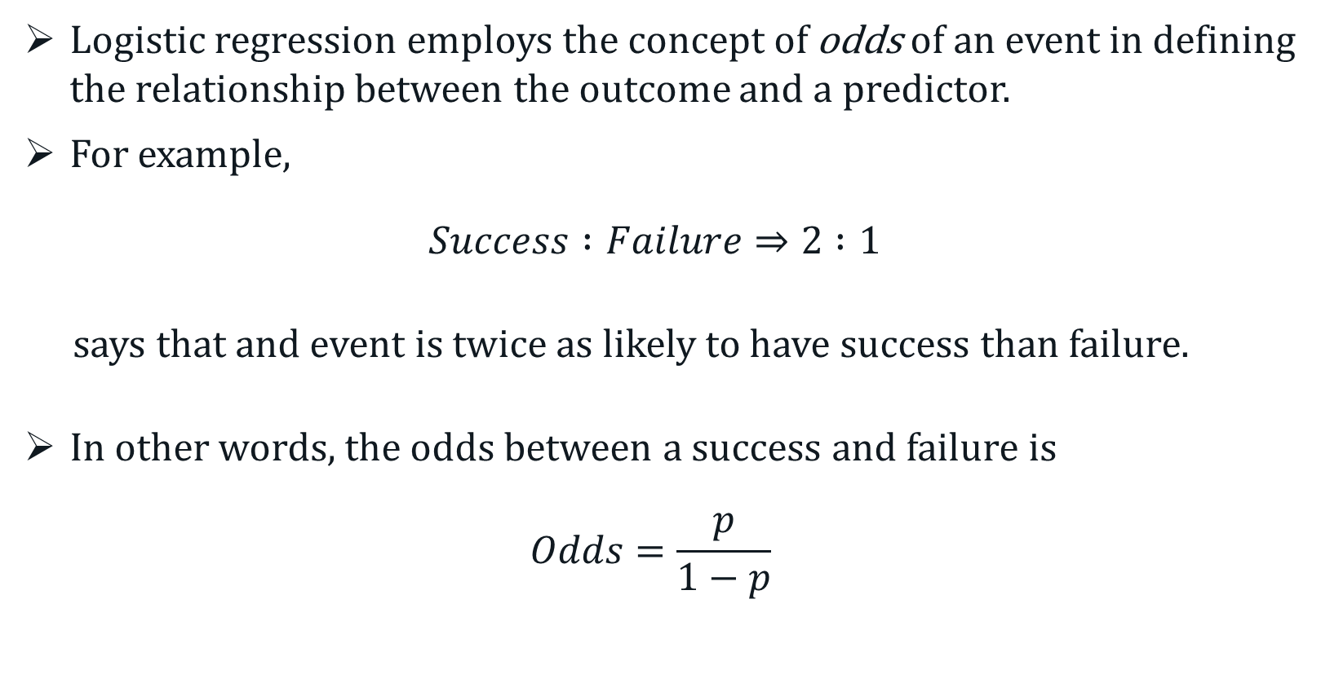
Logistic Regression Modelling
Logistic regression employs the concept of odds of an event in defining the relationship between the outcome and a predictor.
For example,
$$Success :Failure⇒2 :1$$
says that and event is twice as likely to have success than failure.
In other words, the odds between a success and failure is
$$Odds=\frac{p}{1−p}$$
Notes:
Cluster analysis is an “unsupervised” technique and makes no assumptions regarding the number of groups or the group structure.

Slide 8
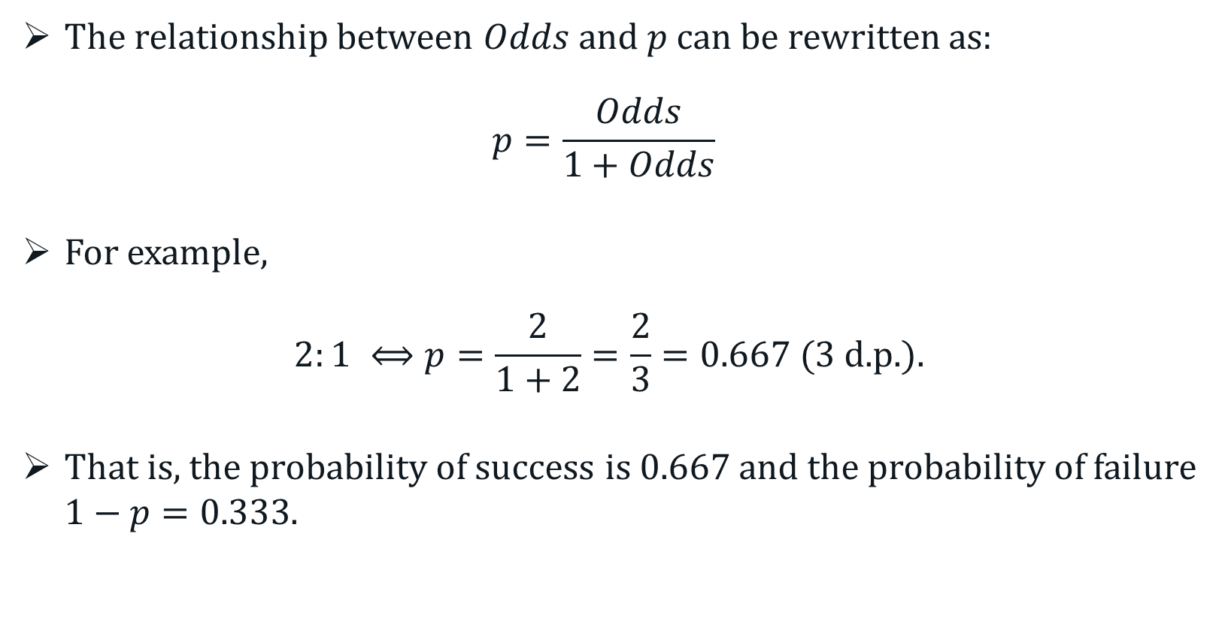
Logistic Regression Modelling
The relationship between $Odds$ and $p$ can be rewritten as:
$$p=\frac{Odds}{1+Odds}$$
For example,
$$2:1 ⟺p=\frac{2}{1+2}=\frac{2}{3}=0.667 (3 \text{d}\text{.}\text{p}\text{.}).$$
That is, the probability of success is $0.667$ and the probability of failure $1−p=0.333$.
Notes:
Cluster analysis is an “unsupervised” technique and makes no assumptions regarding the number of groups or the group structure.

Slide 9
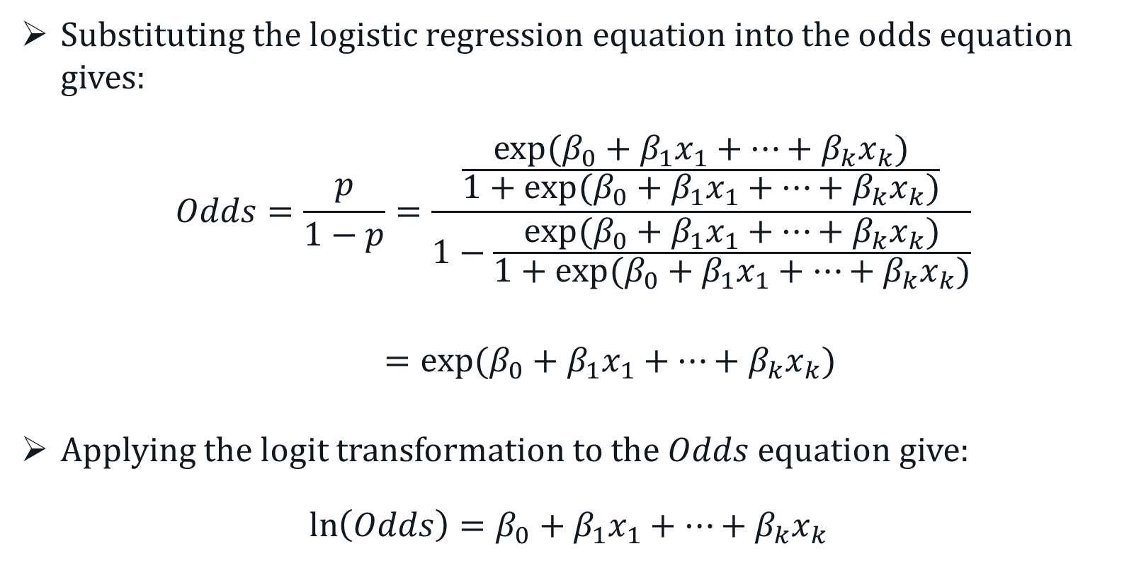
Logistic Regression Modelling
Substituting the logistic regression equation into the odds equation gives:
$$Odds=\frac{p}{1−p}=\frac{\frac{exp⁡(β_{0}+β_{1}x_{1}+…+β_{k}x_{k})}{1+exp⁡(β_{0}+β_{1}x_{1}+…+β_{k}x_{k})}}{1−\frac{exp⁡(β_{0}+β_{1}x_{1}+…+β_{k}x_{k})}{1+exp⁡(β_{0}+β_{1}x_{1}+…+β_{k}x_{k})}}$$
$=exp⁡(β_{0}+β_{1}x_{1}+…+β_{k}x_{k})$
Applying the logit transformation to the $Odds$ equation give:
$$\ln\left(Odds\right)=β_{0}+β_{1}x_{1}+…+β_{k}x_{k}$$
Notes:
Cluster analysis is an “unsupervised” technique and makes no assumptions regarding the number of groups or the group structure.

Slide 10
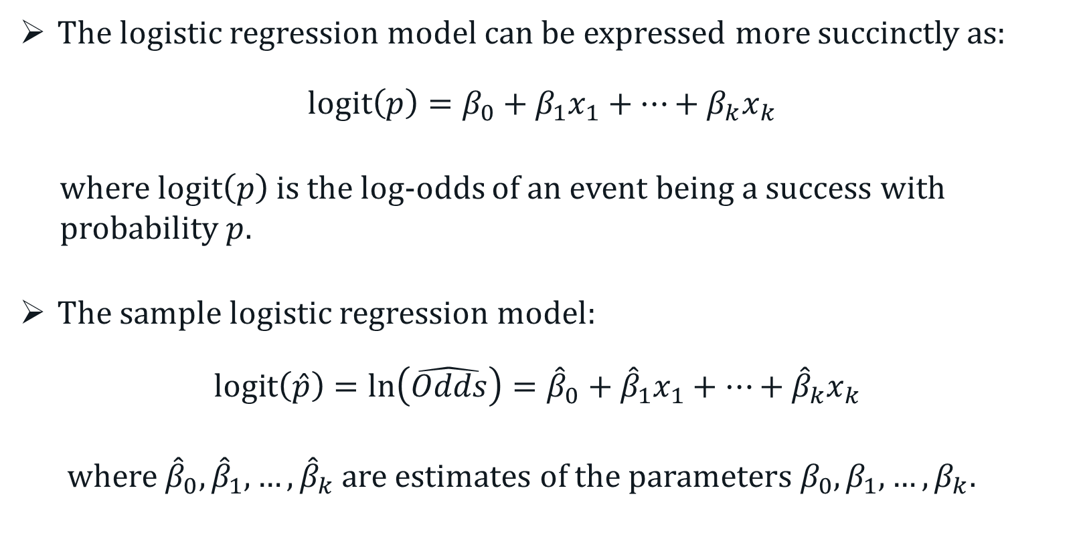
Logistic Regression Modelling
The logistic regression model can be expressed more succinctly as:
$$logit\left(p\right)=β_{0}+β_{1}x_{1}+…+β_{k}x_{k}$$
where $logit\left(p\right)$ is the log-odds of an event being a success with probability $p.$
The sample logistic regression model:
$$logit\left(\hat{p}\right)=ln\left(\hat{Odds}\right)={\hat{β}}_{0}+{\hat{β}}_{1}x_{1}+…+{\hat{β}}_{k}x_{k}$$
where ${\hat{β}}_{0}, {\hat{β}}_{1}, …,{\hat{β}}_{k}$ are estimates of the parameters $β_{0}, β_{1}, …,β_{k}$.
Notes:
Cluster analysis is an “unsupervised” technique and makes no assumptions regarding the number of groups or the group structure.

Slide 11
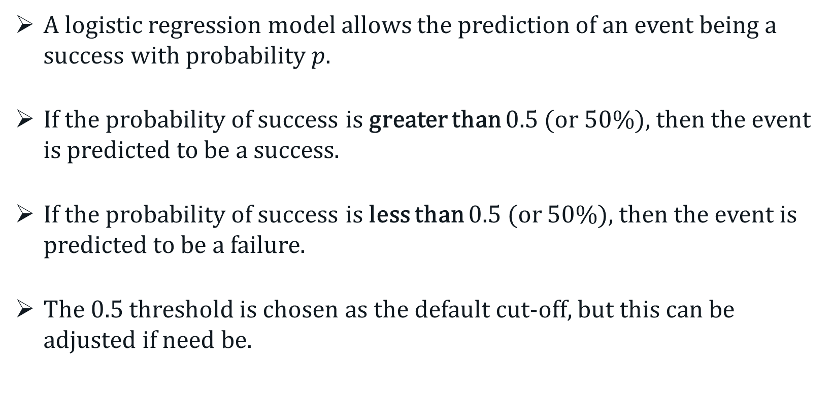
Logistic Regression Modelling
A logistic regression model allows the prediction of an event being a success with probability $p$.
If the probability of success is greater than 0.5 (or 50%), then the event is predicted to be a success.
If the probability of success is less than 0.5 (or 50%), then the event is predicted to be a failure.
The 0.5 threshold is chosen as the default cut-off, but this can be adjusted if need be.
Notes:
More likely than not to be a success.
Less like than not to be a success

Slide 12
Logistic Regression Modelling
Example: Appendicectomy complication
Suppose we have wish construct a prediction model to determine whether a patient is likely to have complication during an appendicitis surgery based on the following patient characteristics and blood tests.
Outcome of interest – Complication (Yes/No*)
Features on interest:
Gender (Male/Female*) – categorical
Age (in years) – continuous
C-reactive protein (CRP) – continuous
White blood cell count (WCC) - continuous
* Reference level
Notes:
More likely than not to be a success.
Less like than not to be a success

Slide 13
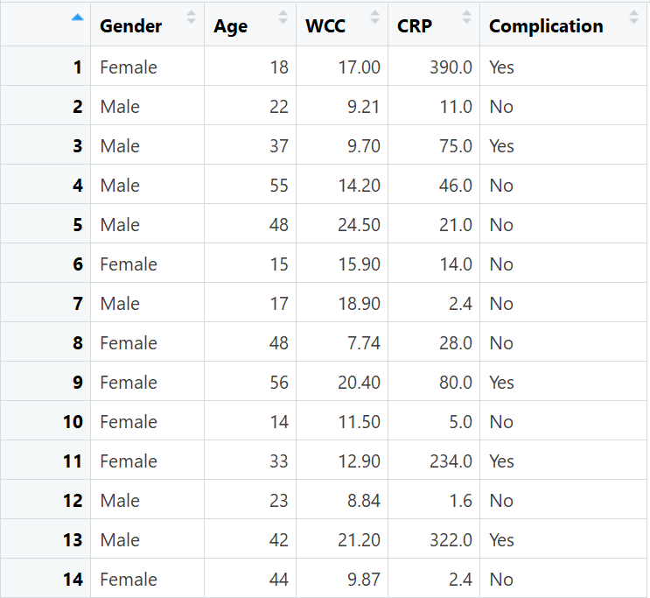
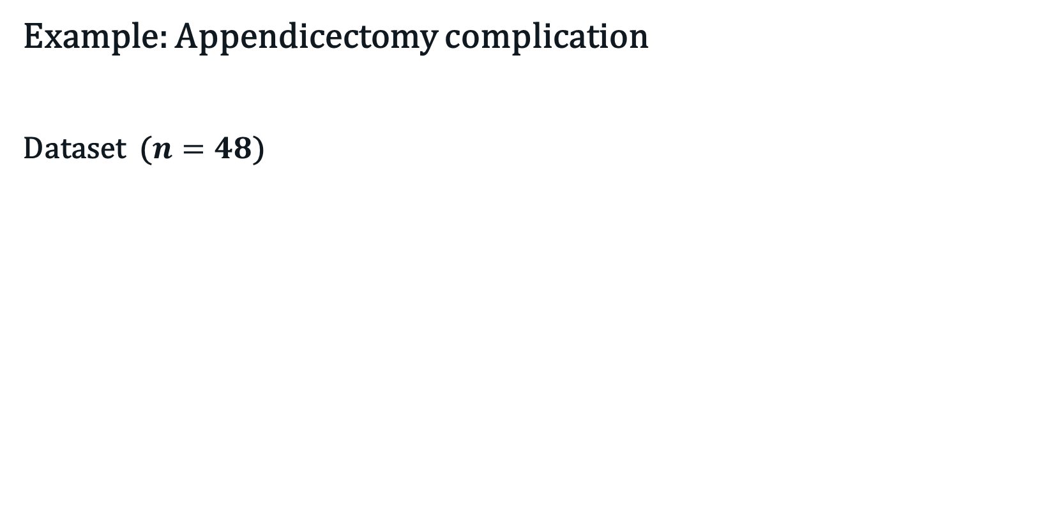
Logistic Regression Modelling
Example: Appendicectomy complication
Dataset ($n=48$)
Notes:
More likely than not to be a success.
Less like than not to be a success

Slide 14
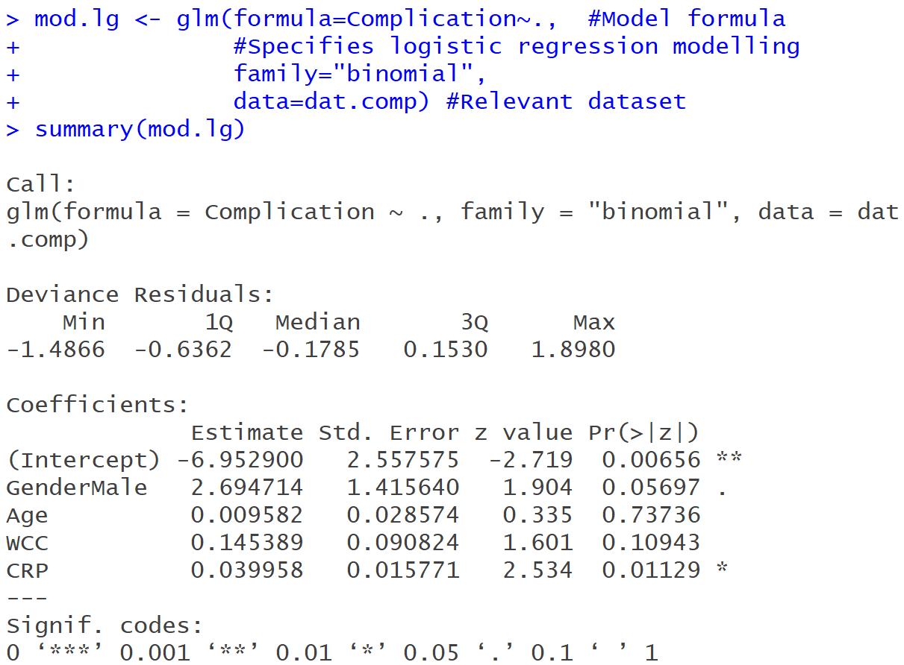
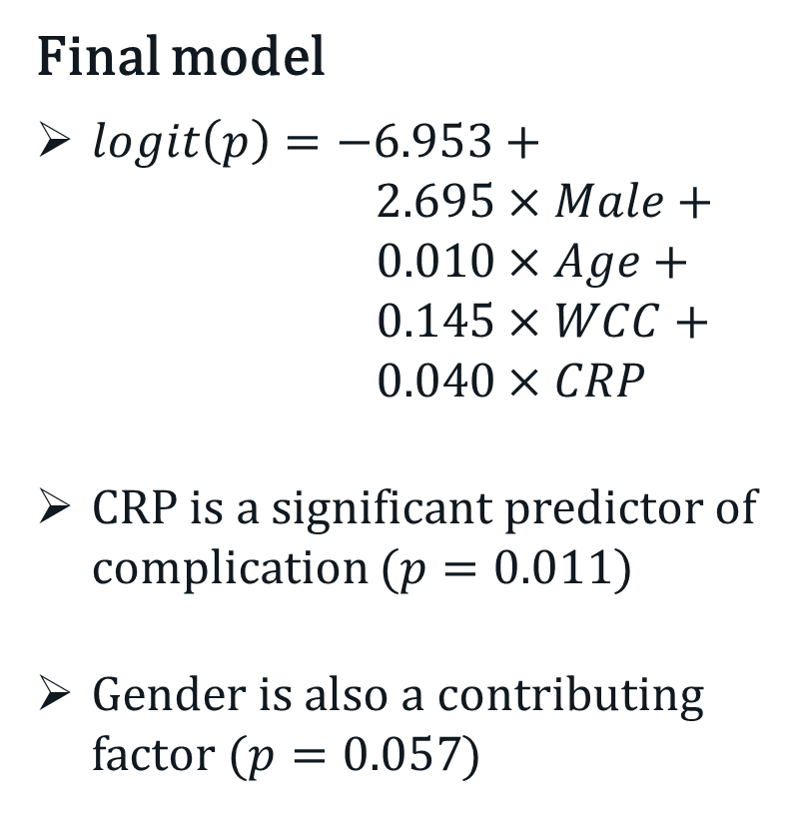
Logistic Regression Modelling
Final model
$logit\left(p\right)=−6.953+$ $2.695×Male+ 0.010×Age+$ $0.145×WCC+$ $0.040×CRP$
CRP is a significant predictor of complication ($p=0.011$)
Gender is also a contributing factor ($p=0.057$)
Notes:
More likely than not to be a success.
Less like than not to be a success

Slide 15
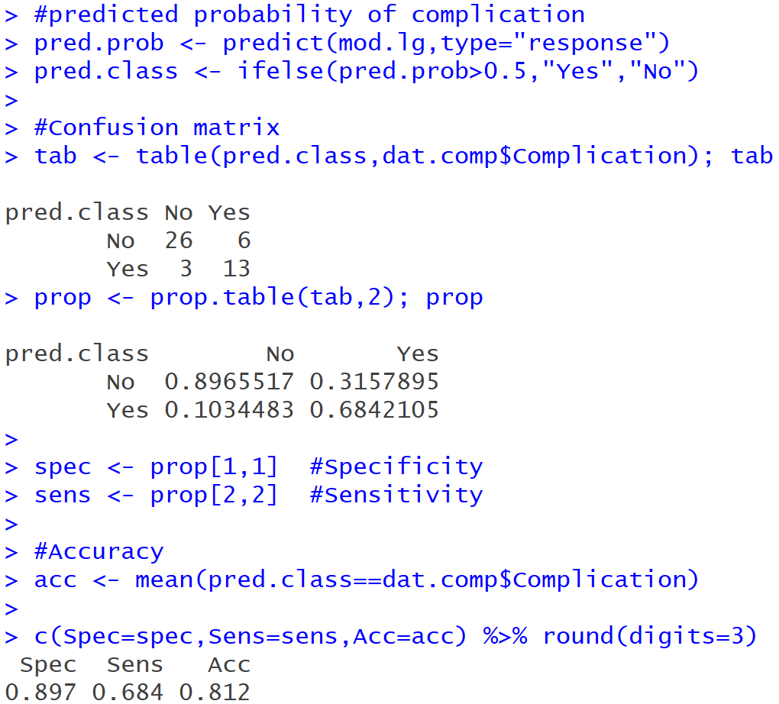
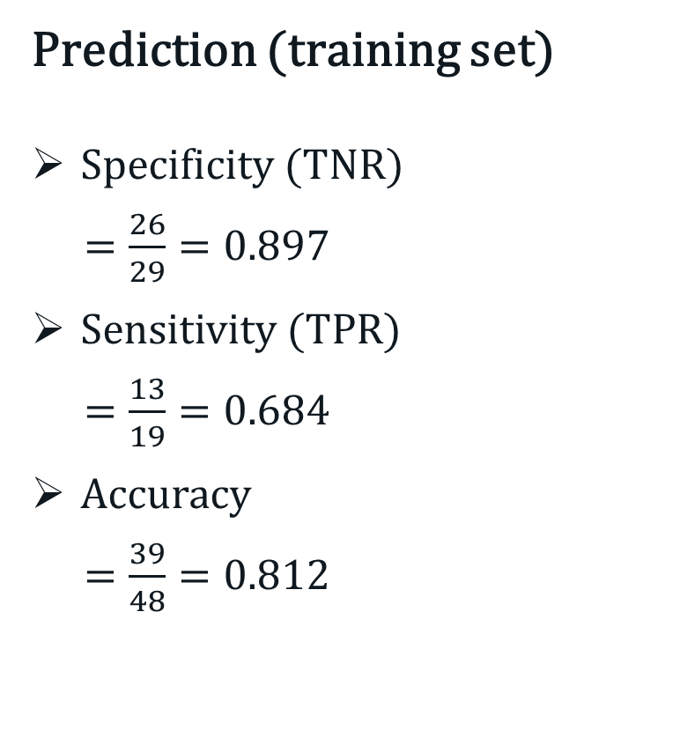
Logistic Regression Modelling
Prediction (training set)
Specificity (TNR)
$=\frac{26}{29}=0.897$
Sensitivity (TPR)
$=\frac{13}{19}=0.684$
Accuracy
$=\frac{39}{48}=0.812$
Notes:
More likely than not to be a success.
Less like than not to be a success

Slide 16
Penalised Logistic Regression Modelling
Three types of penalised logistic regression
Ridge regression
Shrink the regression coefficients toward zero.
LASSO regression
Shrink certain regression coefficients to exactly zero.
Elastic-net regression
A mix between ridge regression and LASSO.
Notes:
More likely than not to be a success.
Less like than not to be a success

Slide 17
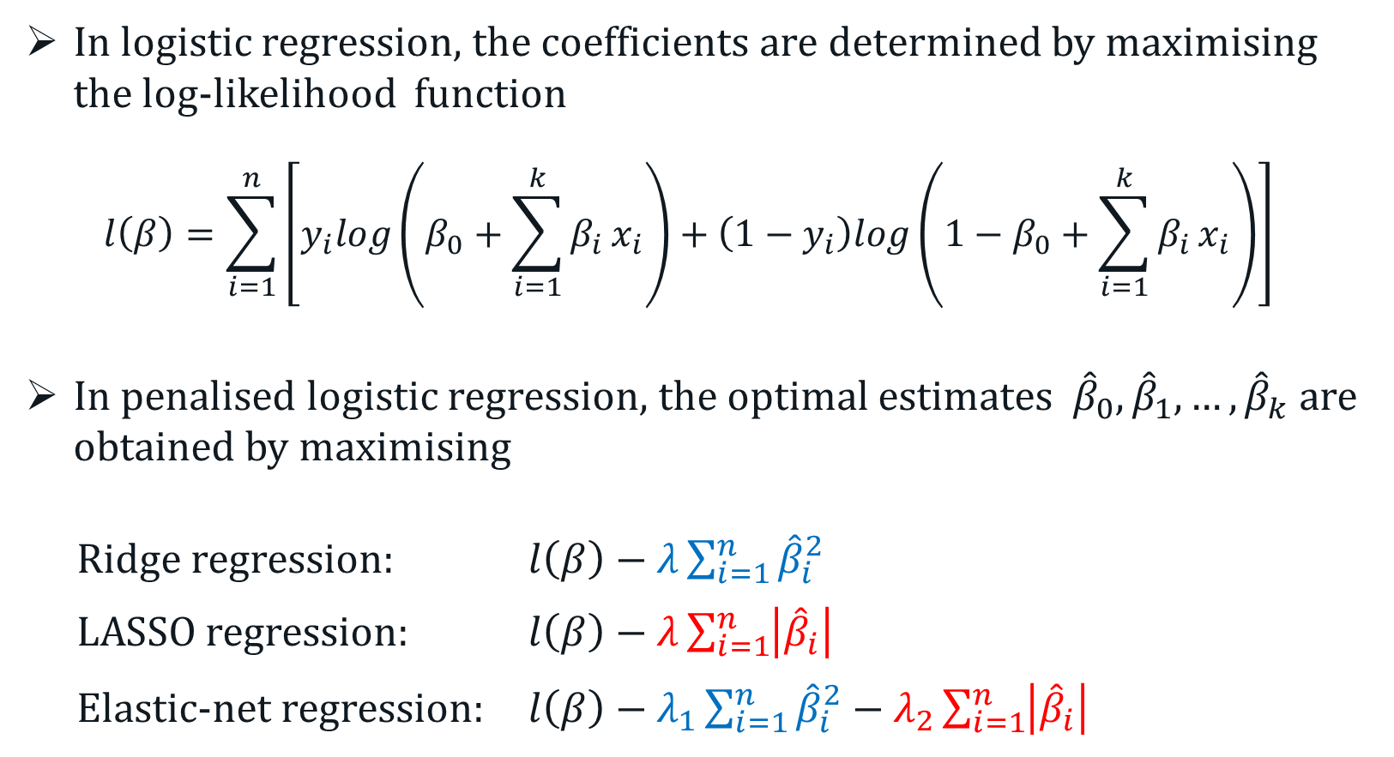
Penalised Logistic Regression Modelling
In logistic regression, the coefficients are determined by maximising the log-likelihood function
$$l\left(β\right)=\sum_{i=1}^{n}{\left[y_{i}log\left(β_{0}+\sum_{i=1}^{k}{β_{i}}x_{i}\right)+\left(1−y_{i}\right)log\left(1−β_{0}+\sum_{i=1}^{k}{β_{i}}x_{i}\right)\right]}$$
In penalised logistic regression, the optimal estimates ${\hat{β}}_{0}, {\hat{β}}_{1}, …,{\hat{β}}_{k}$ are obtained by maximising
Ridge regression: $l\left(β\right)−λ\sum_{i=1}^{n}{{\hat{β}}_{i}^{2}}$
LASSO regression: $l\left(β\right)−λ\sum_{i=1}^{n}{\left|{\hat{β}}_{i}\right|}$
Elastic-net regression: $l\left(β\right)−λ_{1}\sum_{i=1}^{n}{{\hat{β}}_{i}^{2}}−λ_{2}\sum_{i=1}^{n}{\left|{\hat{β}}_{i}\right|}$
Notes:
More likely than not to be a success.
Less like than not to be a success

Slide 18
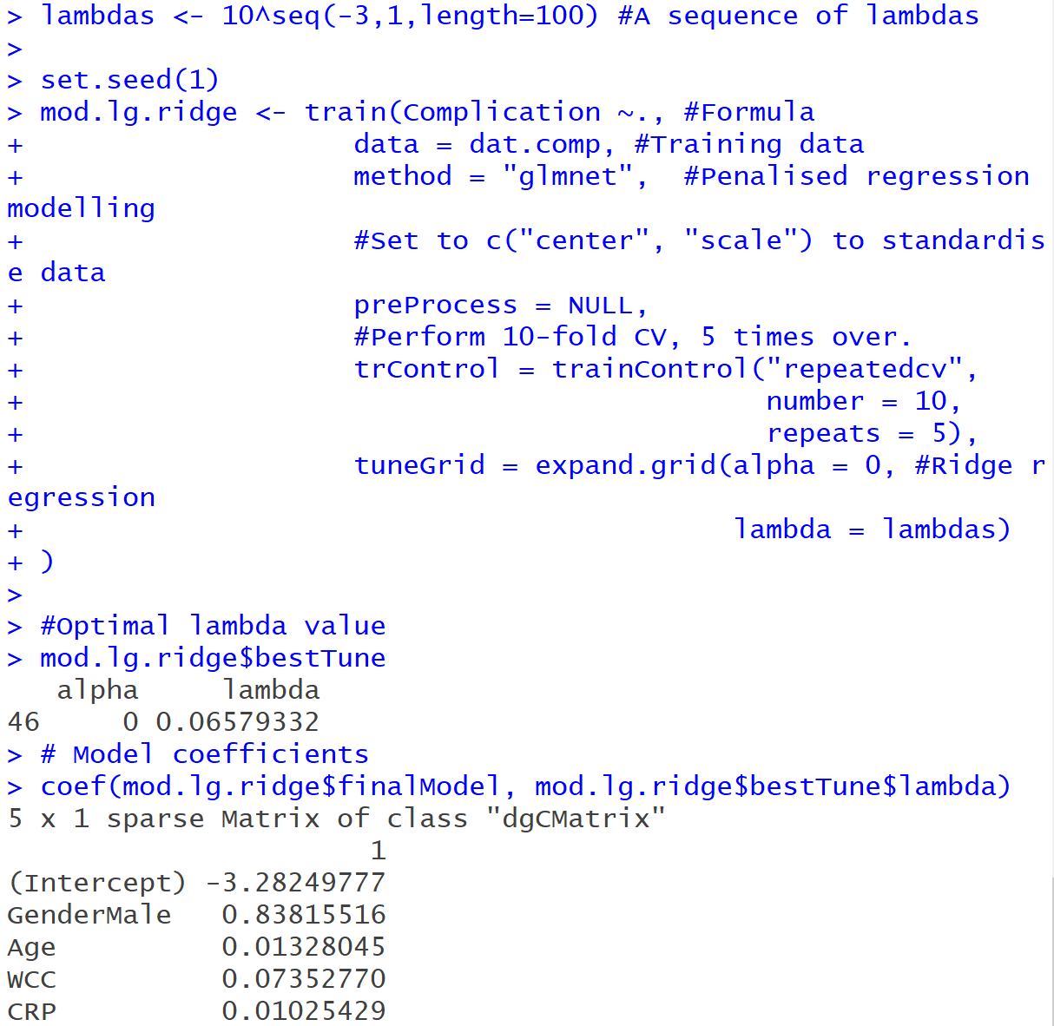
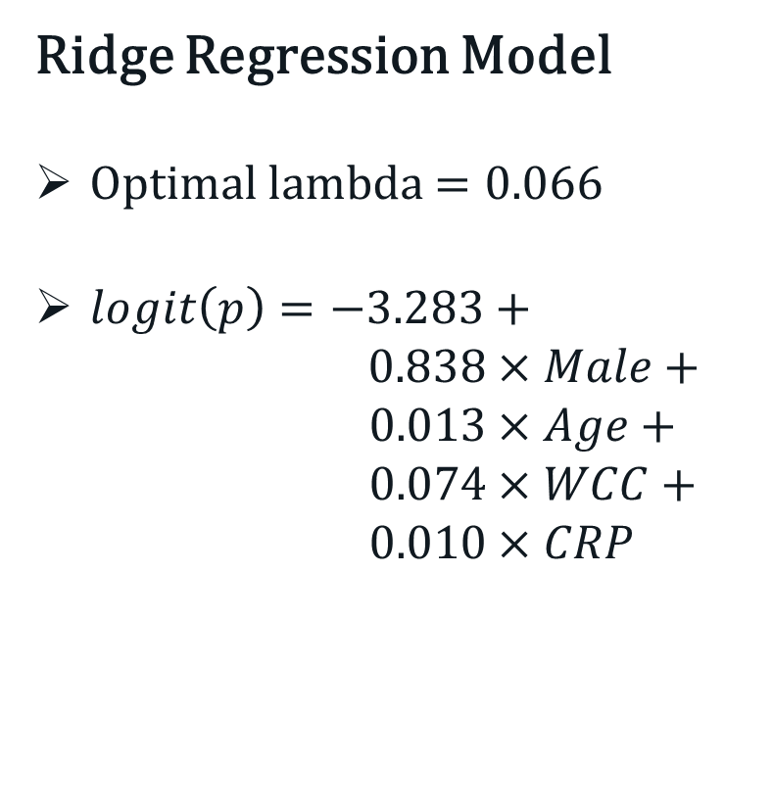
Penalised Logistic Regression Modelling
Ridge Regression Model
Optimal lambda $=0.066$
$logit\left(p\right)=−3.283+$ $0.838×Male+ 0.013×Age+$ $0.074×WCC+$ $0.010×CRP$
Notes:
More likely than not to be a success.
Less like than not to be a success

Slide 19
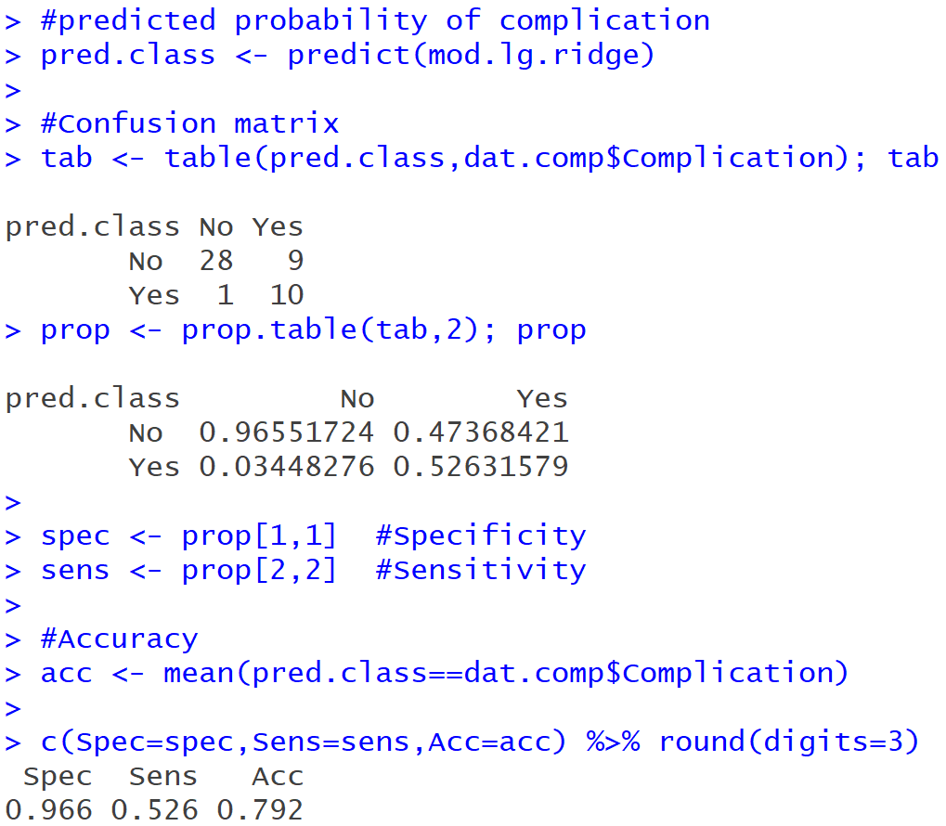
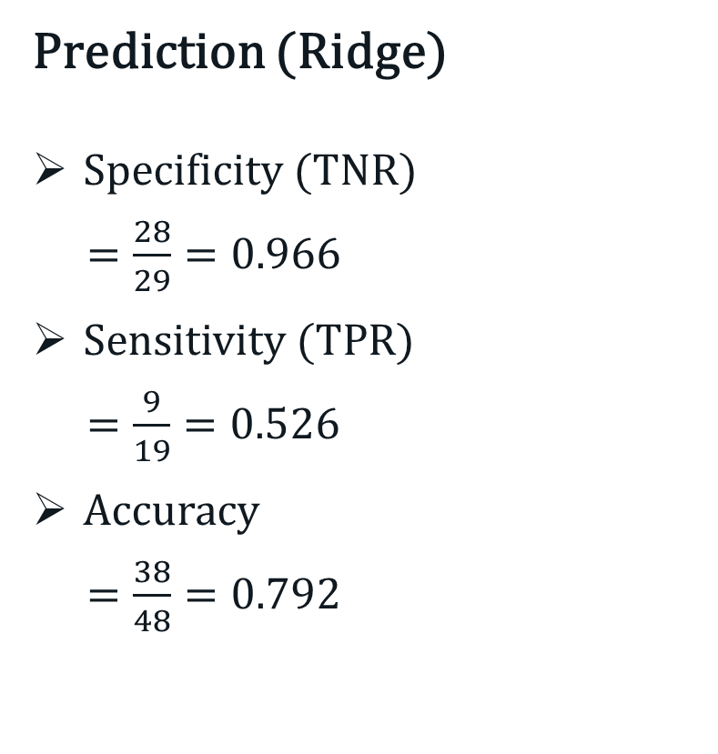
Penalised Logistic Regression Modelling
Prediction (Ridge)
Specificity (TNR)
$=\frac{28}{29}=0.966$
Sensitivity (TPR)
$=\frac{9}{19}=0.526$
Accuracy
$=\frac{38}{48}=0.792$
Notes:
More likely than not to be a success.
Less like than not to be a success

Slide 20
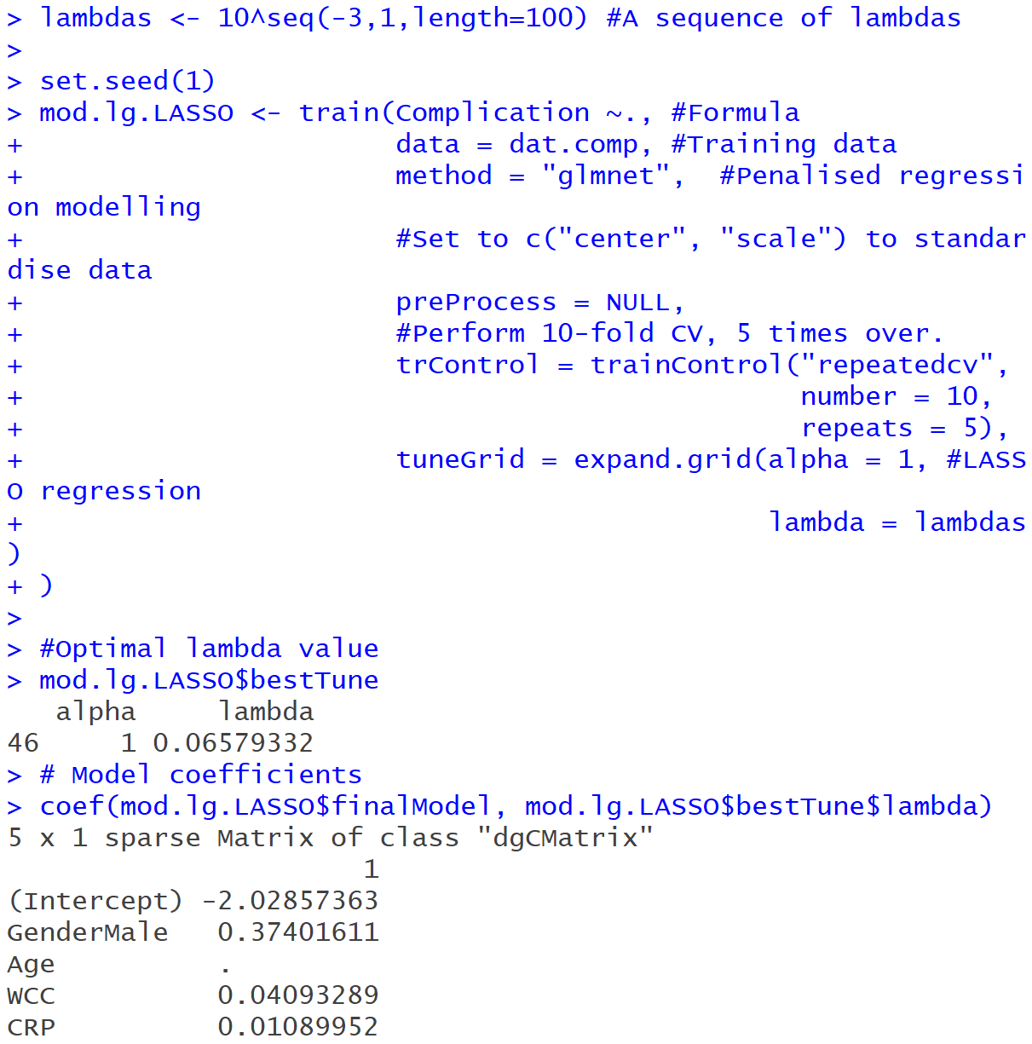
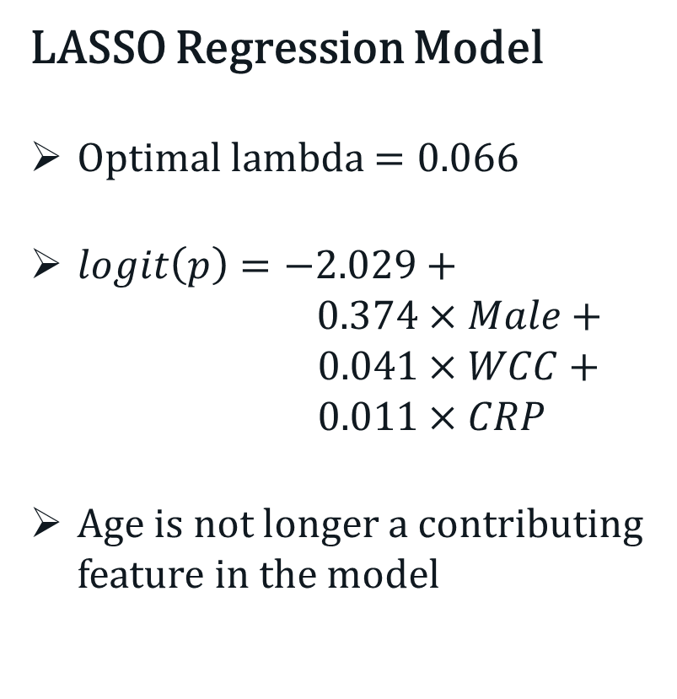
Penalised Logistic Regression Modelling
LASSO Regression Model
Optimal lambda $=0.066$
$logit\left(p\right)=−2.029+$ $0.374×Male+$ $0.041×WCC+$ $0.011×CRP$
Age is not longer a contributing feature in the model
Notes:
More likely than not to be a success.
Less like than not to be a success

Slide 21
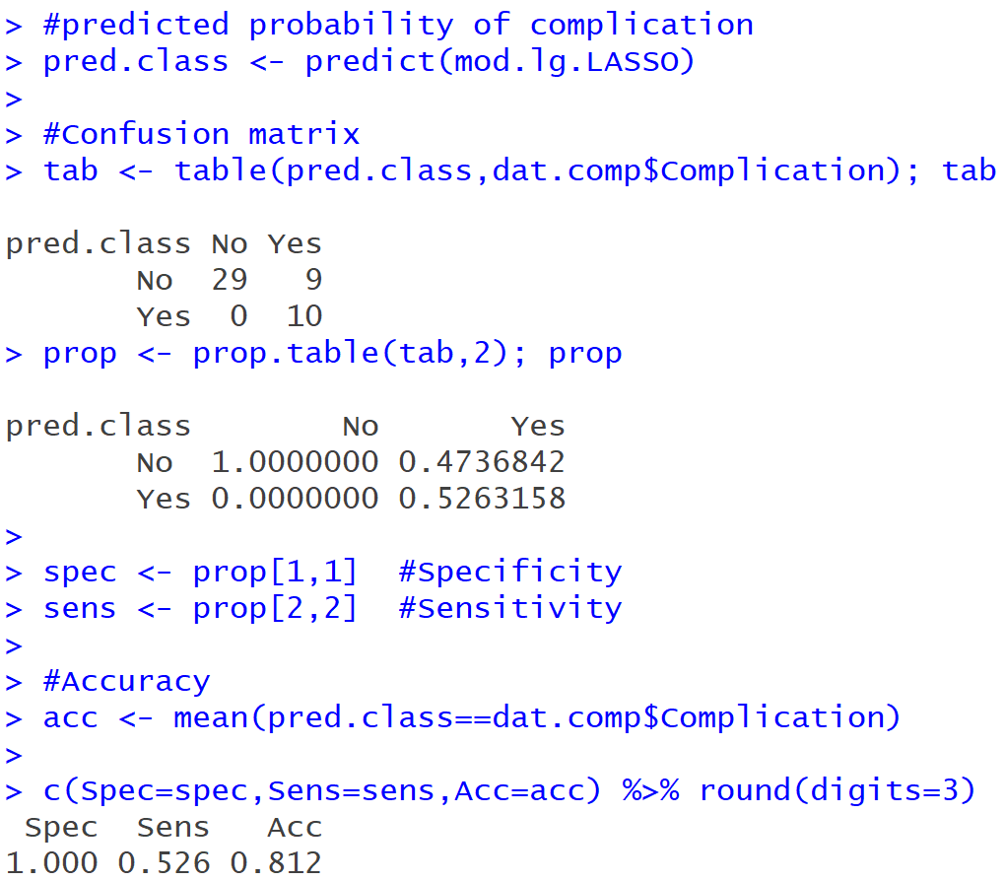
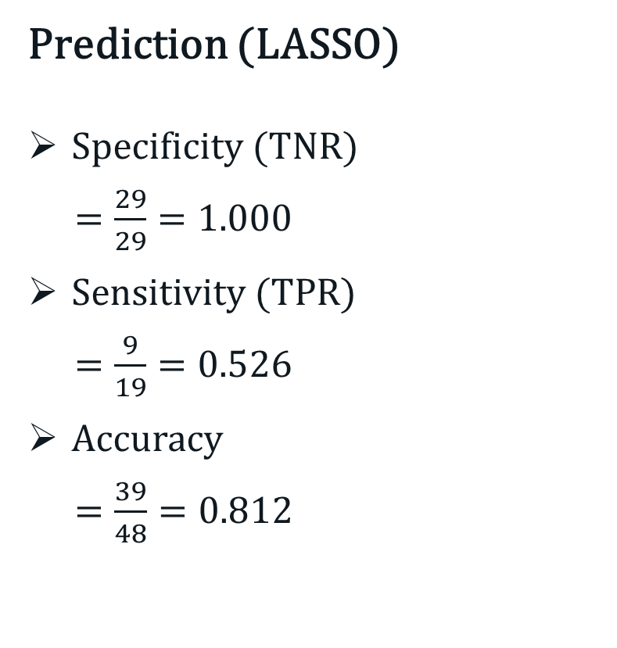
Penalised Logistic Regression Modelling
Prediction (LASSO)
Specificity (TNR)
$=\frac{29}{29}=1.000$
Sensitivity (TPR)
$=\frac{9}{19}=0.526$
Accuracy
$=\frac{39}{48}=0.812$
Notes:
More likely than not to be a success.
Less like than not to be a success

Slide 22
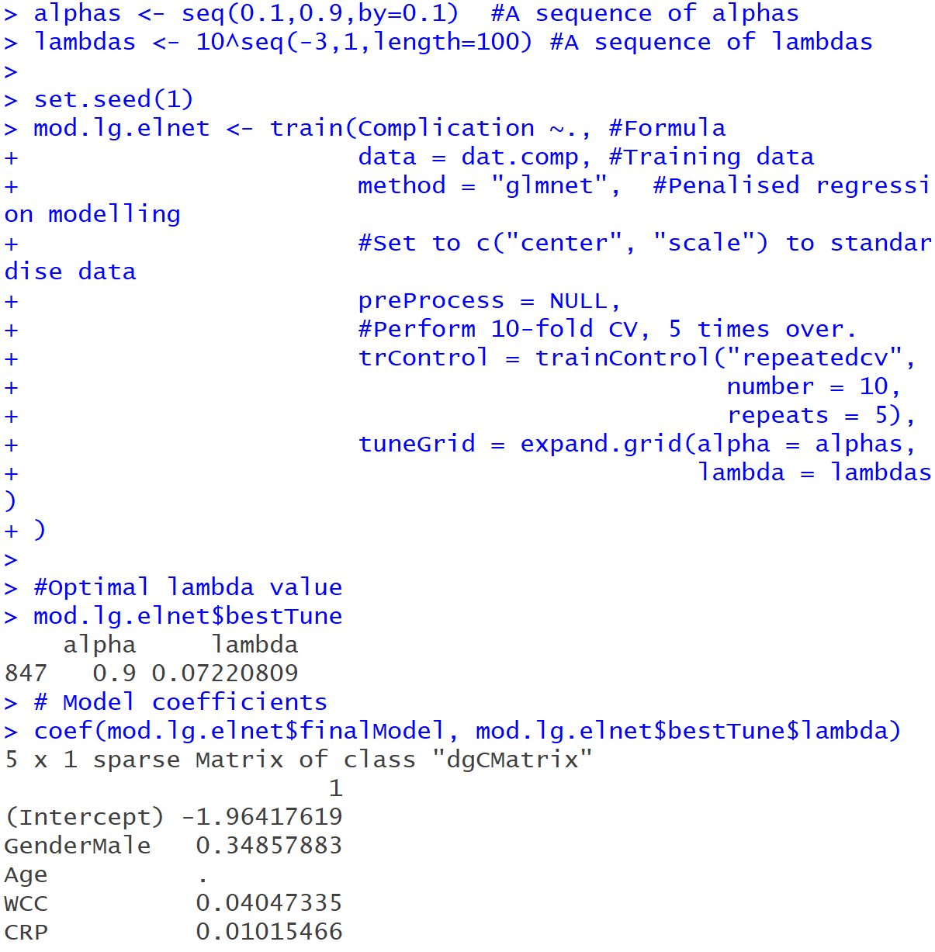
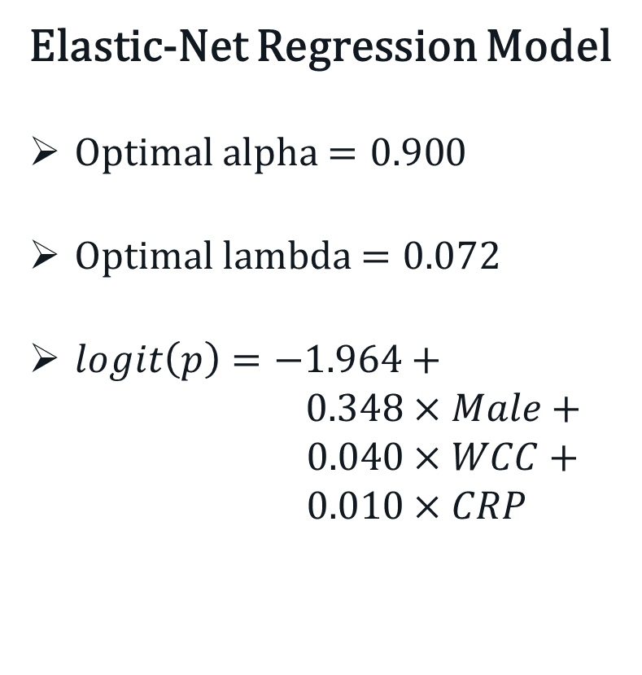
Logistic Regression Modelling
Elastic-Net Regression Model
Optimal alpha $=0.90$0
Optimal lambda $=0.072$
$logit\left(p\right)=−1.964+$ $0.348×Male+ 0.040×WCC+$ $0.010×CRP$
Notes:
More likely than not to be a success.
Less like than not to be a success

Slide 23

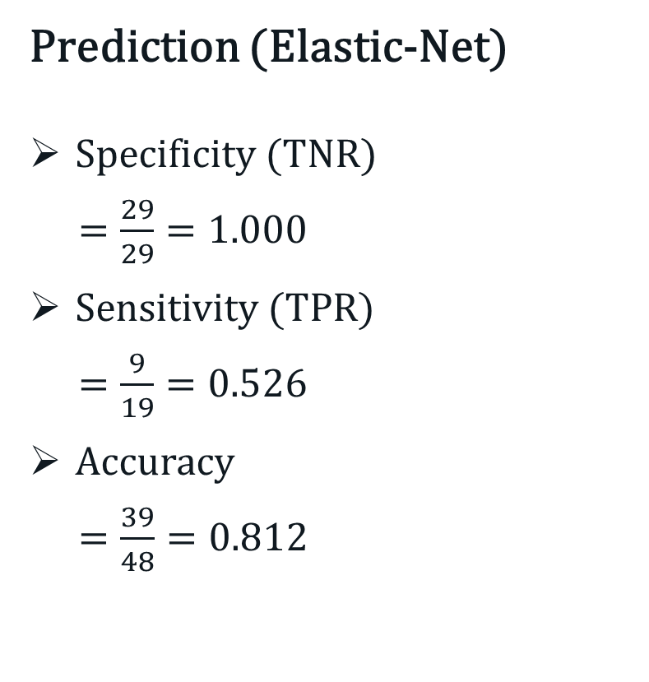
Penalised Logistic Regression Modelling
Prediction (Elastic-Net)
Specificity (TNR)
$=\frac{29}{29}=1.000$
Sensitivity (TPR)
$=\frac{9}{19}=0.526$
Accuracy
$=\frac{39}{48}=0.812$
Notes:
More likely than not to be a success.
Less like than not to be a success

